Slide 1
Robert Rauschenberg Foundation Archives
~Test-Repository Finding Aid Code~
Examples & Instructions
EAD XML to CSV Conversion using Python and Terminal

Slide 2
Project Parameters Github Repository : https://github.com/Super10veBug/rrfa-pfch-2019
This project is in response to the Robert Rauschenberg Foundation’s Archives (RRFA) request for a CSV formatted finding aid to facilitate shipping of materials for digitization and storage.
The EAD XML finding aid used for this conversion is an export from ArchivesSpace. The finding aids are selections from collections RRFA01 – Rauschenberg Papers and RRFA02 – Audiovisual.
My purpose was to supply RRFA with a reusable script, and instructions that can be followed by the archivists and future interns.

Slide 3
Background
Running this code requires:
Installation of Python3;
Some knowledge of command line tools & navigation;
And a text editor for coding.
This script uses “for” loops, a python dictionary, and the following modules:
CSV, ElementTree, and Regular Expressions.
The rest of this document will be instructional.

Slide 4
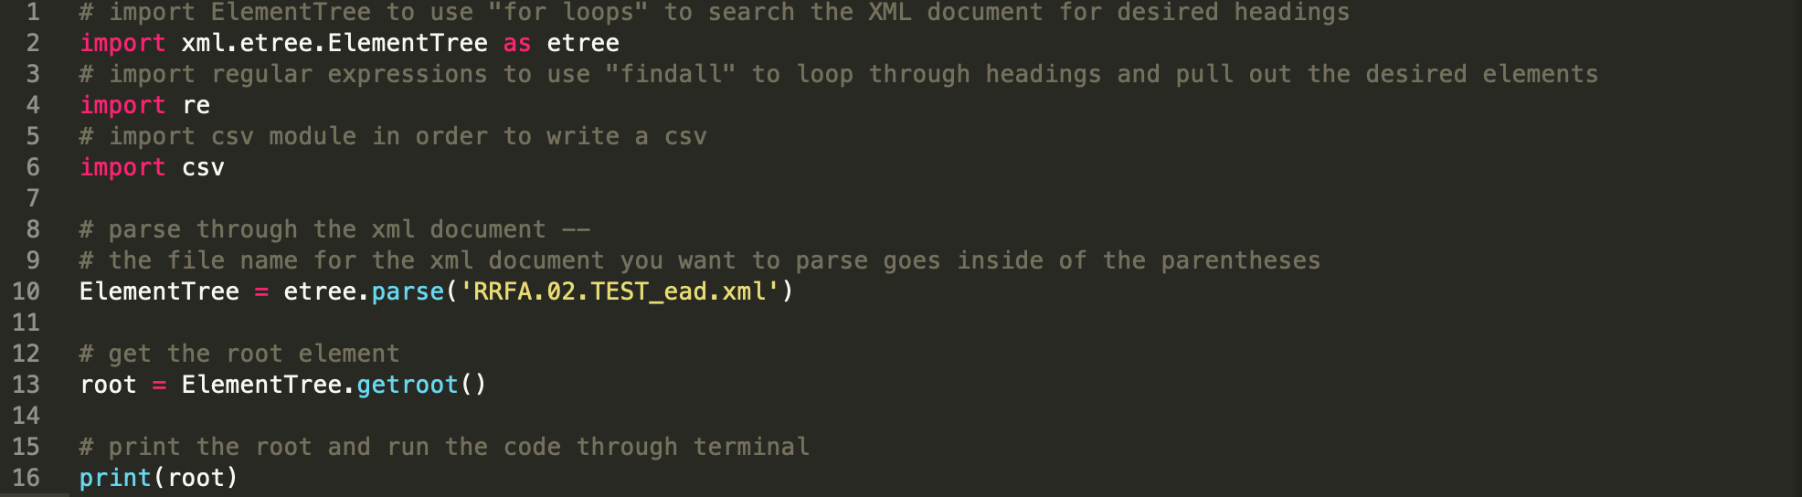
Step One - Import modules and find the root element
Save your XML EAD file and your Python file (code from the text editor) in the same folder on your computer. These are the first steps for the code. The yellow address in quotes ‘’ is the name of the xml finding aid. It must be exact. Grey text following the # sign are comments (in this case, instructions) and will not affect the code.

Slide 5
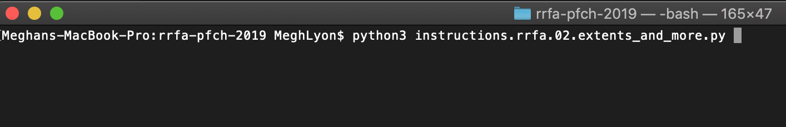
Step One - Terminal Side
Run the code through the terminal first by navigating to the folder/directory in which you’ve saved your Python file—I saved my files in the directory “rrfa-pfch-2019”

Slide 6
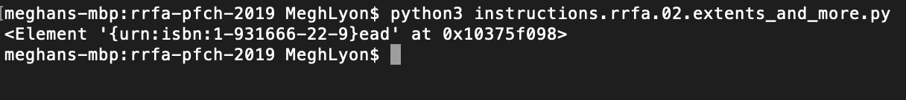
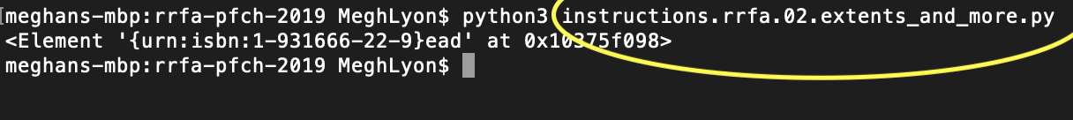
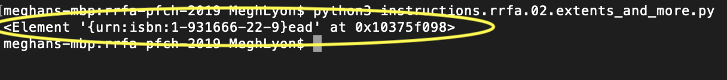
Step One - Terminal Side Part 2
This is the result
Inside of this circle, you’ll see we have printed the root element, which is ead.

Slide 7
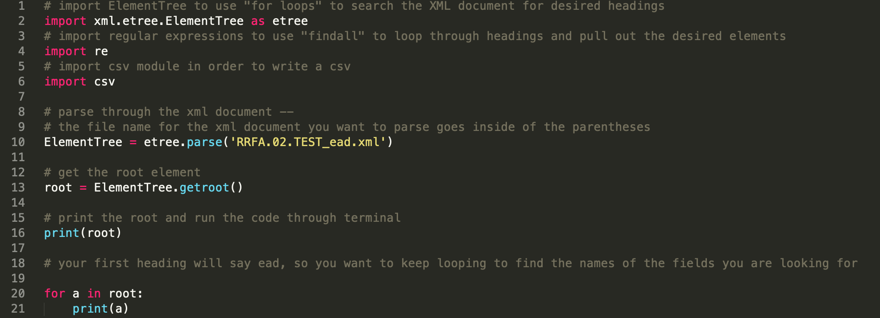
Step Two
As you see from the comment on line 18 - you need to find the root and then child elements of EAD to find the fields we want to eventually write in the CSV.

Slide 8
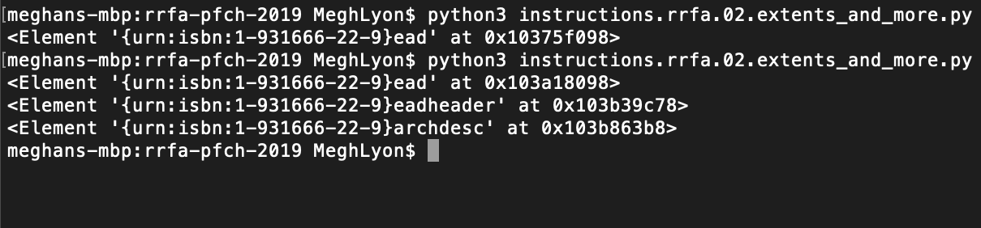
Step Two Continued
This is the printed result of the first for loop, we are looking for container information (box numbers), titles, extent data and location -- as we can clearly see in our XML file, but we are looping to find the addresses for our code. The addresses may change depending on the output, so we need to look for each XML Finding Aid that is exported from ArchivesSpace.

Slide 9
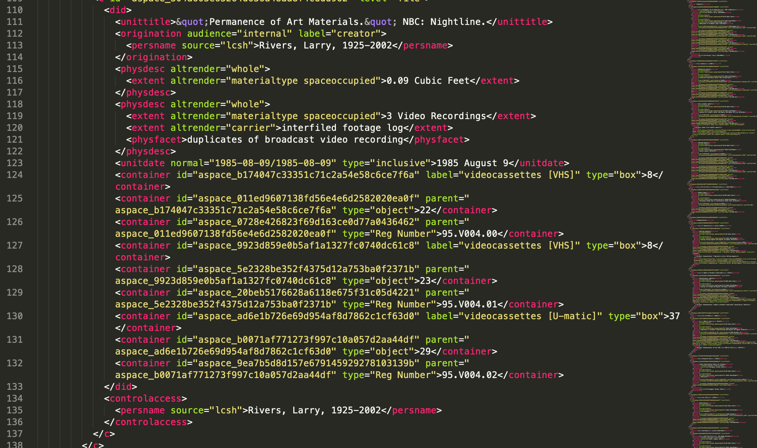
We are looping through the nested elements under <did>
To extract text from between <extent>, <physfacet>,
<container>,
and
<unittitle>

Slide 10
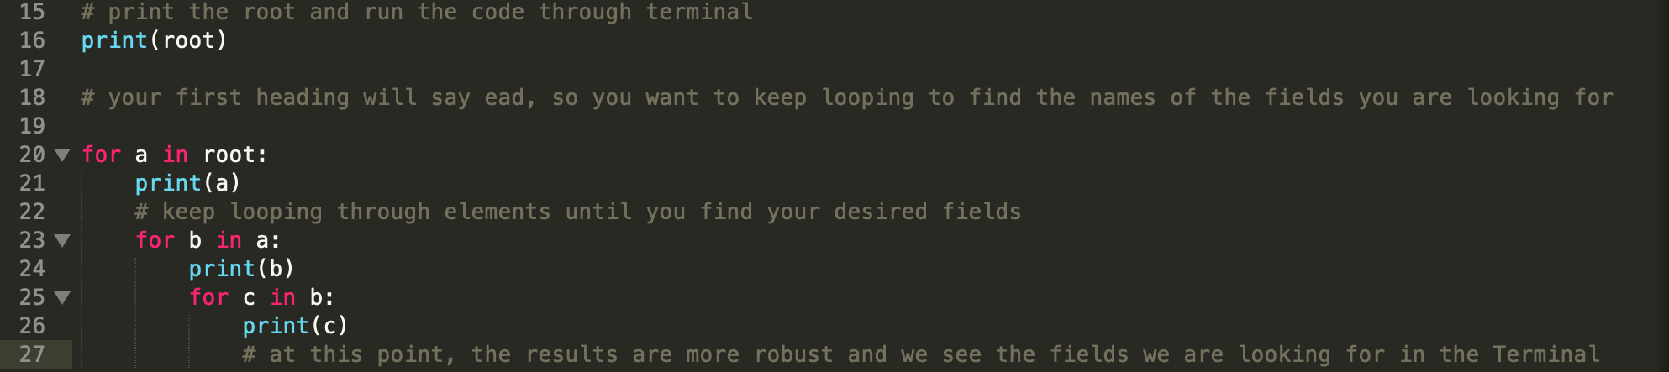
Step Three - Looping through the elements
(a, b, and c are variables)

Slide 11
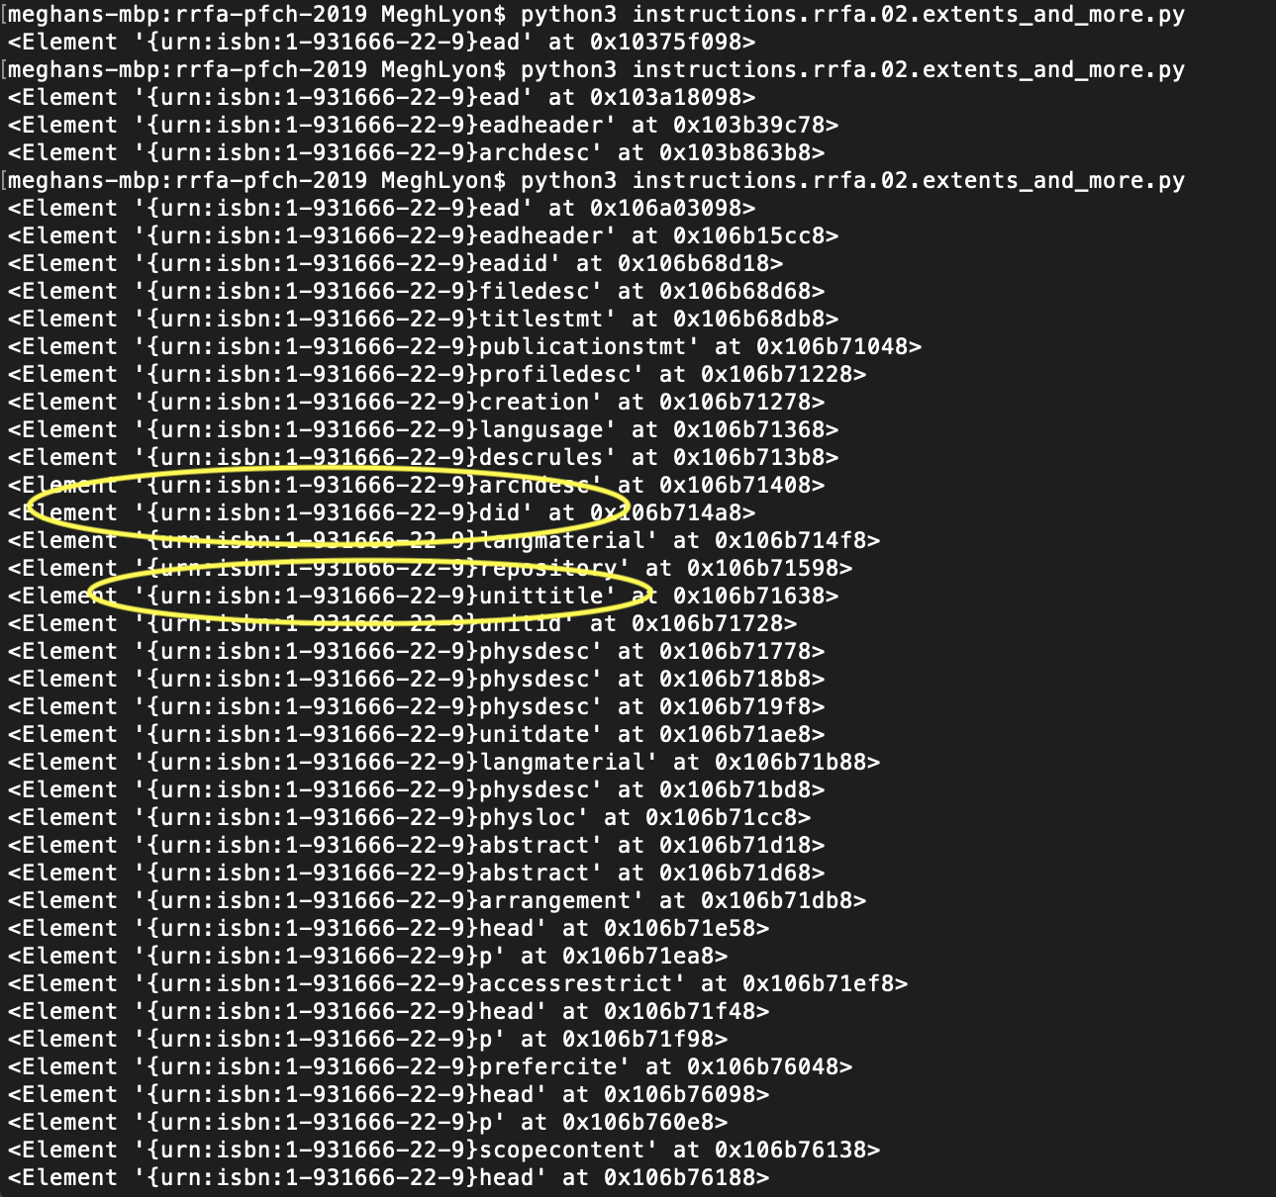
The number in the curly brackets {} is really all we need to do our regular expression. But we can find the other elements just to check.

Slide 12
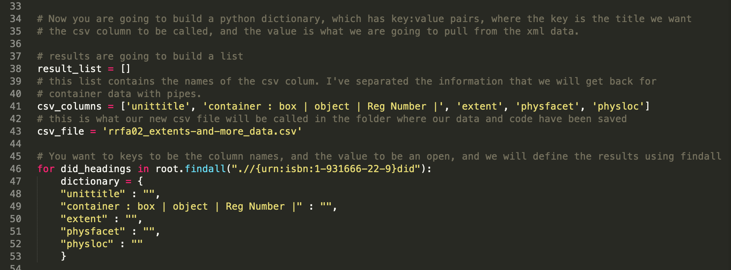
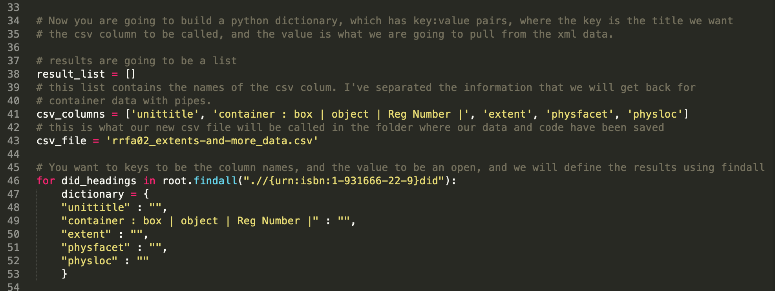
Step Four - “Findall” and Python Dictionary

Slide 13
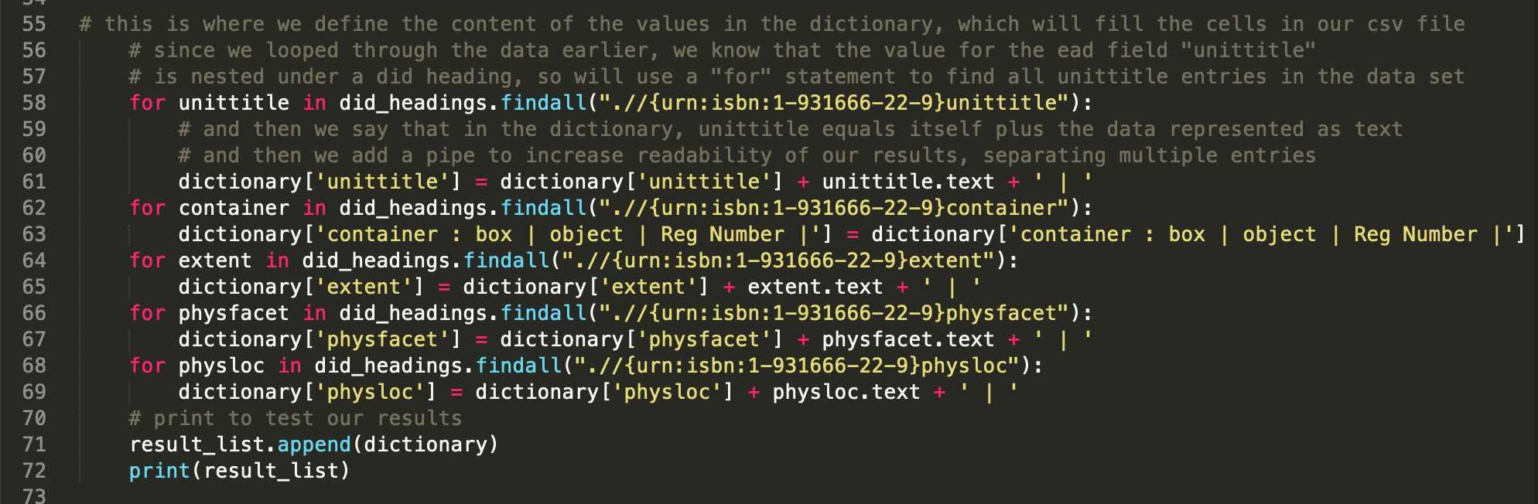

Slide 14
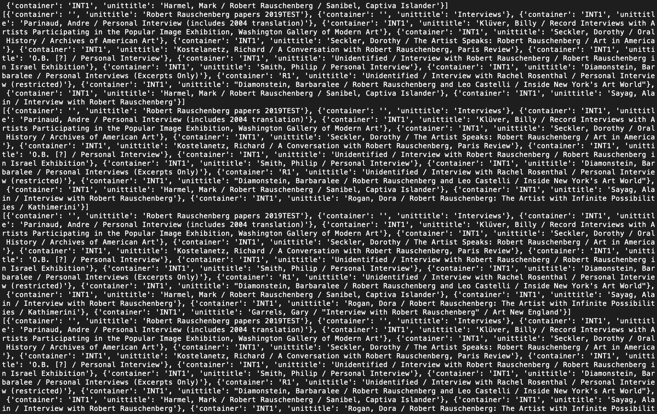
This is what our dictionary should look like when we run the code through the terminal.

Slide 15
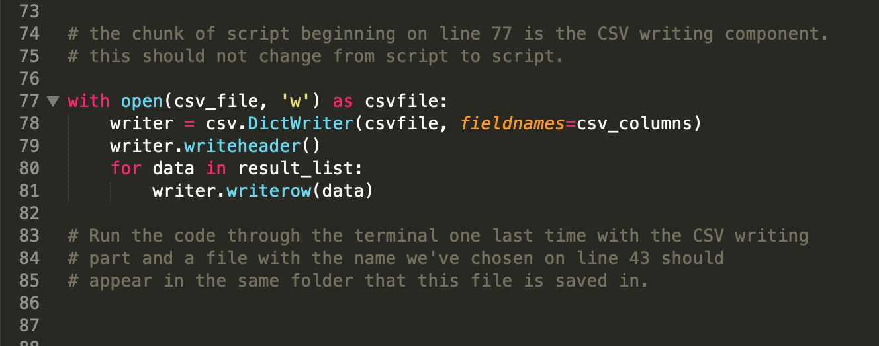
Step Five - CSV Writer

Slide 16
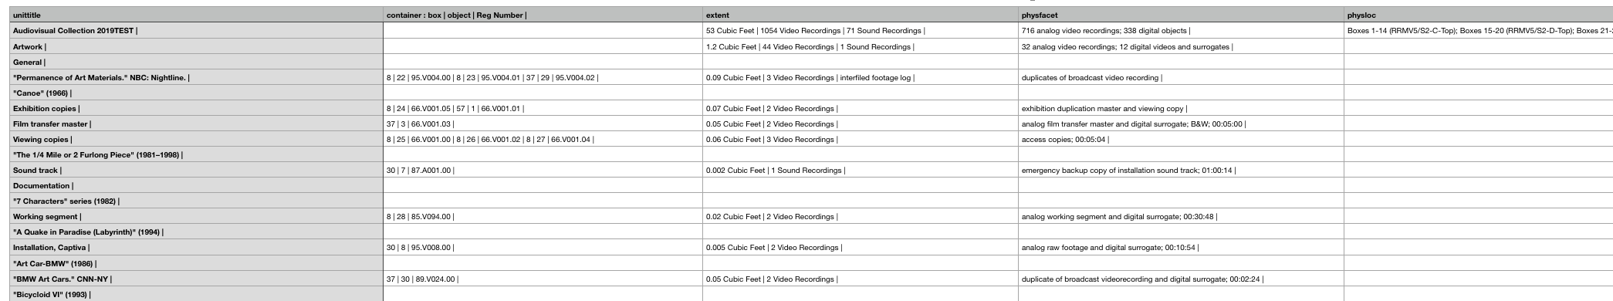
Last step
Run the code through the terminal one last time, and look for your CSV in the folder where the code and the data are saved.
Result should look something like this. Values are separated with pipes and hierarchies are represented in unittitle. Don’t change the column order!!

Slide 17
Github!!
All files related to this project, including XML files, working Python codes, clean-finished codes, and codes with instructions are located …
https://github.com/Super10veBug/rrfa-pfch-2019
Thank you!
Feel free to e-mail questions or concerns

Slide 18
Helpful Links
Lastly - some helpful links for Python
https://wiki.python.org/moin/ForLoop
https://docs.python.org/3.7/library/csv.html
https://docs.python.org/3/library/re.html

